Slide 1
HEALTHCARE DATA ANALYSIS USING PYTHON
HEALTHCARE DATA ANALYSIS PRESENTATION
Minor Project
Submitted By: B. Geetha
Department:CSE(Data science)
College Name:CMR Technical campus
Academic Year: 2025-2026

Slide 2
Introduction
Healthcare organizations generate large amounts of patient data.
Analyzing healthcare data helps identify disease patterns and risk factors.
Data analytics supports healthcare decision-making.
Diabetes is one of the most common chronic diseases worldwide.
This project focuses on analyzing diabetes healthcare data using Python

Slide 3
Problem Statement
Diabetes affects millions of people globally.
Early detection is essential to prevent complications.
Manual analysis of patient records is difficult and time-consuming.
Data analysis techniques are required to identify significant health patterns

Slide 4
Objectives
Analyze diabetes-related healthcare data.
Perform data cleaning and preprocessing.
Identify important diabetes risk factors.
Visualize healthcare trends.
Generate meaningful healthcare insights.
Support data-driven healthcare decisions.

Slide 5
Need for the Project
Increasing number of diabetes patients.
Need for effective healthcare analysis.
Better understanding of disease patterns.
Support healthcare professionals in decision-making.
Improve patient care through data-driven insights.

Slide 6
Technologies Used
Programming Language:
Python Libraries:
Pandas
NumPy
Matplotlib
Seaborn
Development Tool:
Jupyter Notebook Operating System:
Windows

Slide 7
Dataset Description
Dataset Information:
Total Records: 768
Total Attributes: 9 Attributes:
Pregnancies
Glucose
BloodPressure
SkinThickness
Insulin
BMI
DiabetesPedigreeFunction
Age
Outcome Outcome:
0 = Non-Diabetic
1 = Diabetic

Slide 8
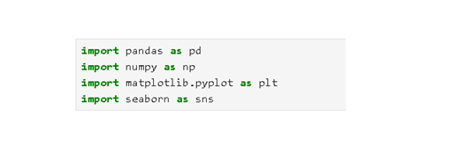
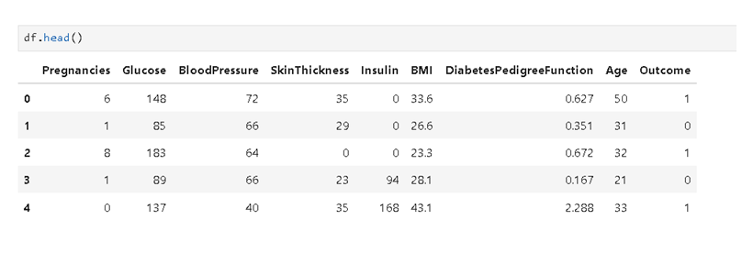

Slide 9
Methodology
Dataset Collection
Data Loading
Data Preprocessing
Data Cleaning
Exploratory Data Analysis Visualization
Correlation Analysis
Results & Findings
Conclusion

Slide 10
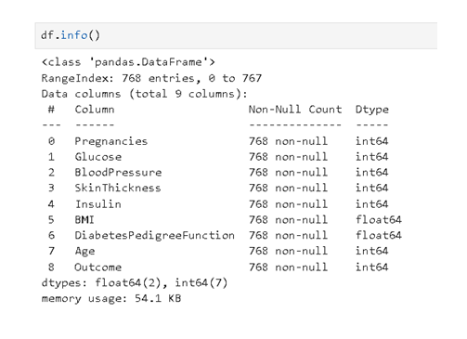
Data Preprocessing
Activities Performed:
Loaded dataset into Jupyter Notebook.
Checked data structure using df.info().

Slide 11
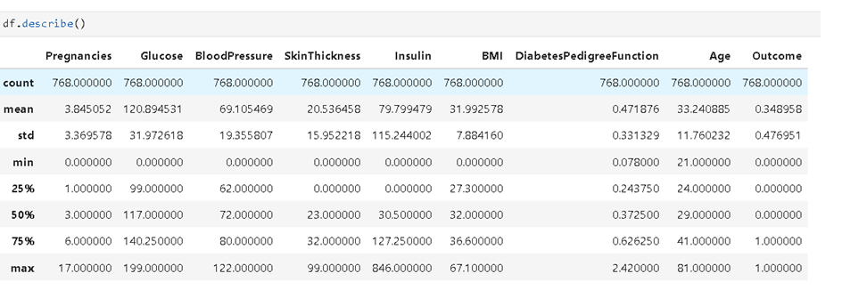
Generated statistical summary using df.describe().

Slide 12
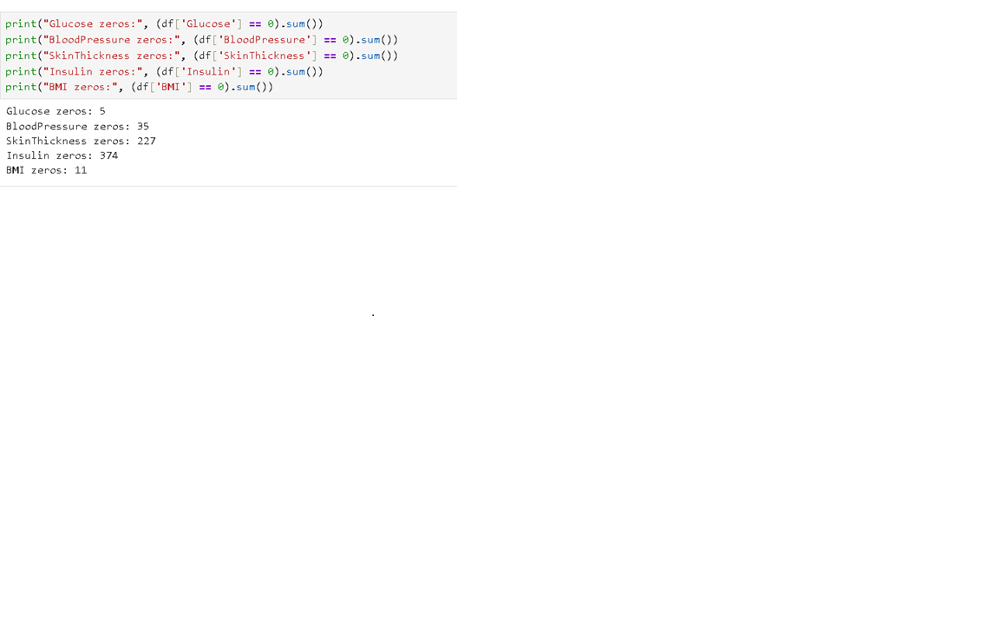
Identified invalid zero values.
Replaced zero values using median values.
Verified cleaned dataset.
Benefits:
Improved data quality.
Increased analysis accuracy.

Slide 13
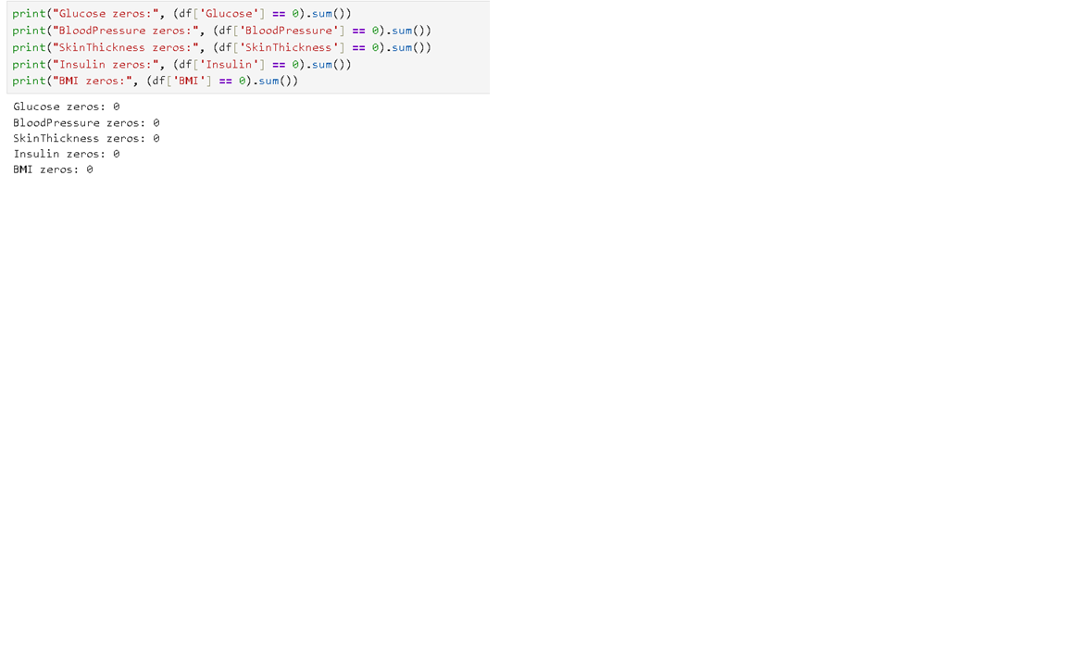

Slide 14
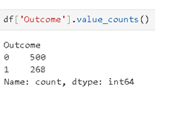
Exploratory Data Analysis
Analysis Performed:
Diabetes Distribution Analysis

Slide 15
Age Distribution Analysis
Glucose Distribution Analysis
BMI Analysis
Correlation Analysis Purpose:
Understand patient characteristics.
Discover healthcare trends.

Slide 16
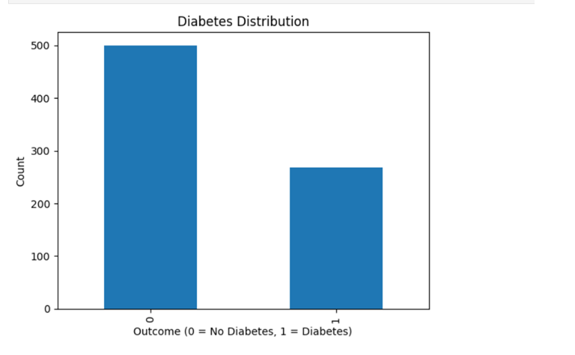
Data Visualization
Visualizations Created:
Diabetes Distribution
Chart

Slide 17
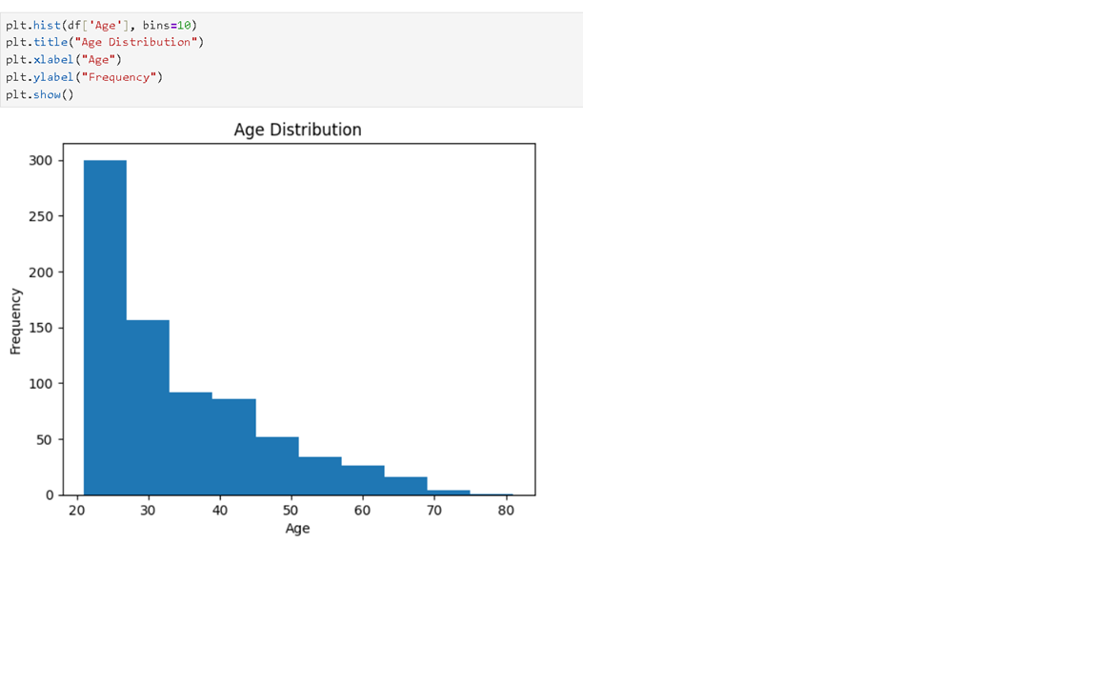
Age Distribution Histogram

Slide 18
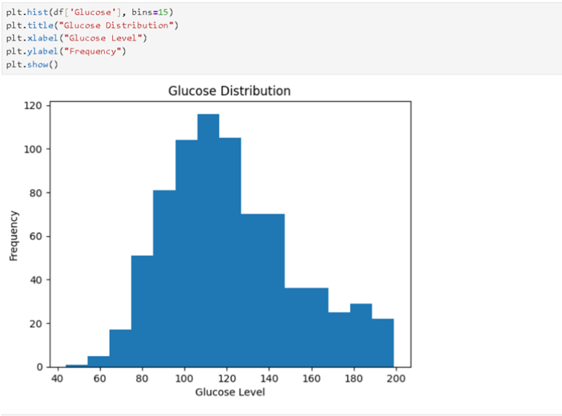
Glucose Distribution Histogram

Slide 19
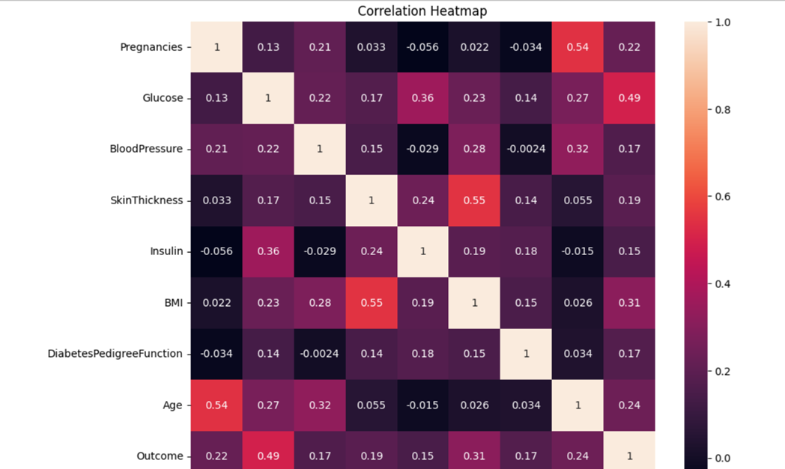
Correlation Heatmap

Slide 20
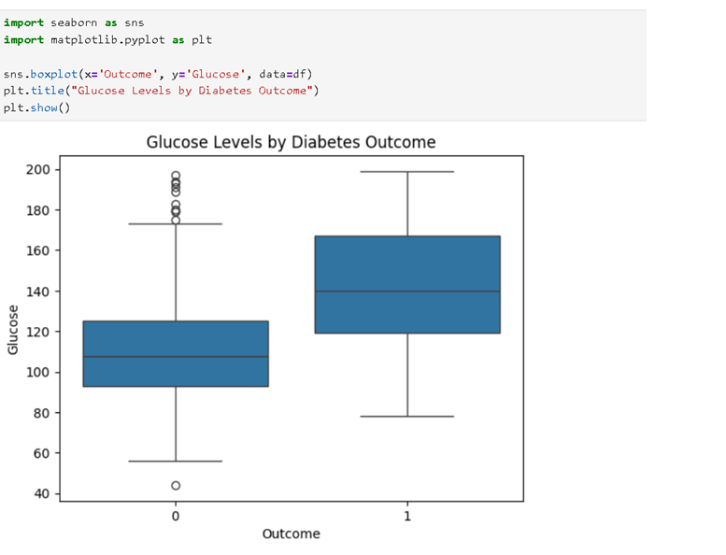
Glucose Levels by Diabetes Outcome

Slide 21
Correlation Analysis
Correlation Results:
Glucose = 0.493
BMI = 0.312
Age = 0.238
Pregnancies = 0.222
SkinThickness = 0.189
DiabetesPedigreeFunction = 0.174
BloodPressure = 0.166
Insulin = 0.148
Observation:
Glucose shows the strongest relationship with diabetes occurrence.

Slide 22
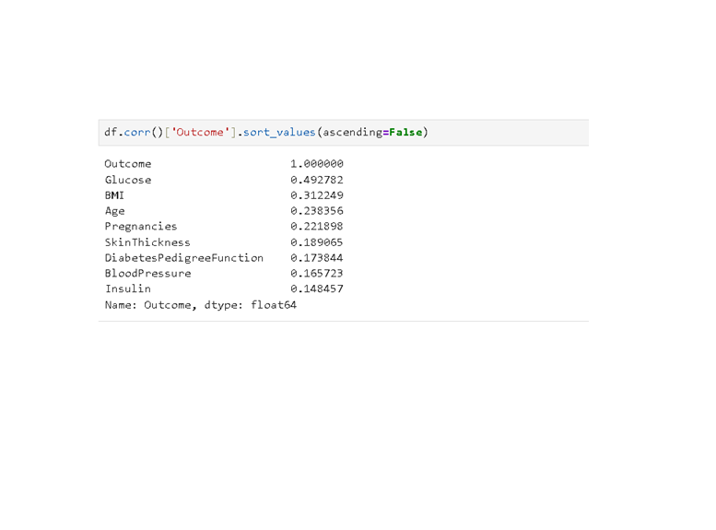
The analysis shows that glucose level has the strongest relationship with diabetes.

Slide 23
Results and Findings
Average Values:
Non-Diabetic Patients
Glucose = 110.68
BMI = 30.88
Age = 31.19
Diabetic Patients
Glucose = 142.13
BMI = 35.38
Age = 37.07

Slide 24
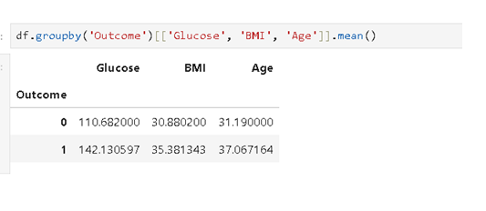
Key Findings:
Higher glucose levels increase diabetes risk.
Higher BMI is associated with diabetes.
Older individuals have a greater chance of developing diabetes.

Slide 25
Advantages and Applications
Advantages:
Identifies diabetes risk factors. • Supports healthcare decisions.
Provides meaningful healthcare insights.
Demonstrates practical use of Python.
Applications:
Hospitals
Clinics
Medical Research Centers
Healthcare Organizations
Public Health Monitoring

Slide 26
Conclusion
Successfully analyzed diabetes healthcare data.
Identified key diabetes risk factors.
Glucose, BMI, and Age are the most influential attributes.
Data analytics can improve healthcare decision-making.

Slide 27
Future Scope:
Diabetes prediction using Machine Learning.
Healthcare dashboards.
Real-time patient monitoring.
AI-based disease prediction systems

Slide 28
THANK YOU

